Slide 1

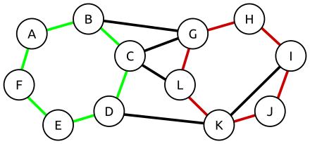
Longest Simple Circuit

Slide 2

CONTENT
PROBLEM DESCRIPTION
ALGORITHM DESCRIPTION
ALGORITHM ANALYSIS
EXPERIMENTAL ANALYSIS
TESTING
DISCUSSION

Slide 3

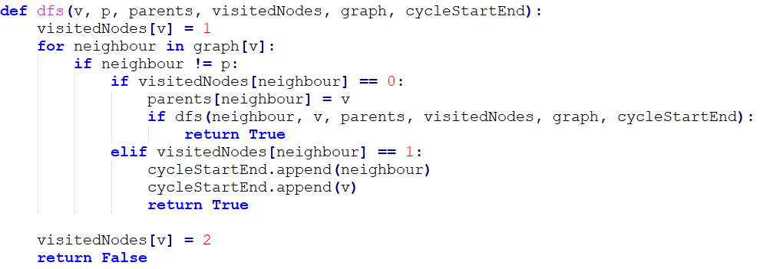
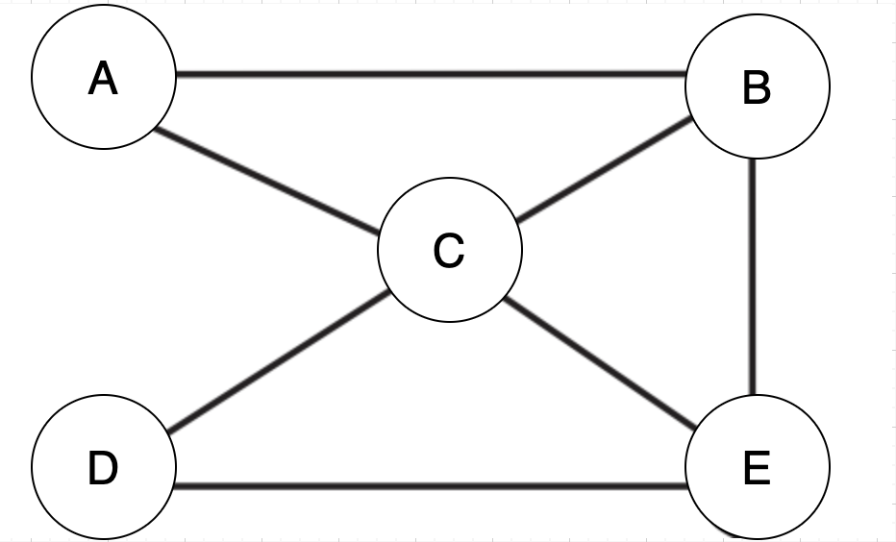
PROBLEM DESCRIPTION
Longest Circuit in undirected graph is cycle of maximum length that contains the maximum number of vertices.
An n-node undirected graph G(V,E) where V is the set of n vertices V = {v1,v2,v3….,vn} E is the set of m edges.
The problem is to find the longest path from u to u with the maximum edge length.

Slide 4

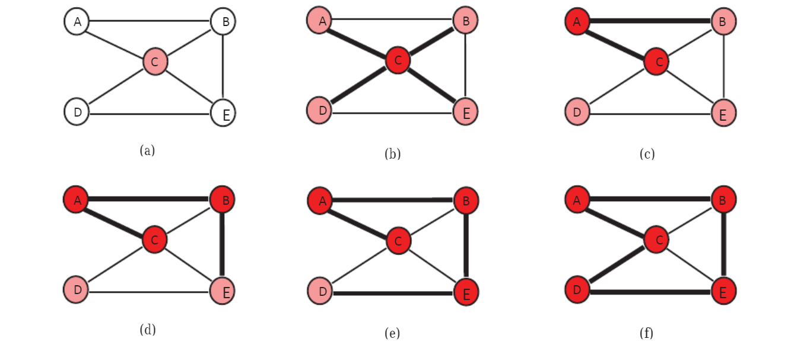
Application of Longest Circuit in Everyday Life
Nowadays, with the increasing amount of data, has become more
complicated.
To give an example of the areas where they are used, they become significant in numerous real-world applications especially in complex networks including analysis of social networks or bioinformatics.

Slide 5
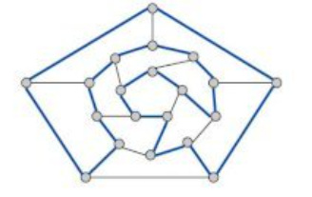
NP-Completeness
Longest Circuit is a NP-complete problem.
Longest Circuit is a reduction of the Hamiltonian Cycle problem.

Slide 6
ALGORITHM DESCRIPTION

Slide 7
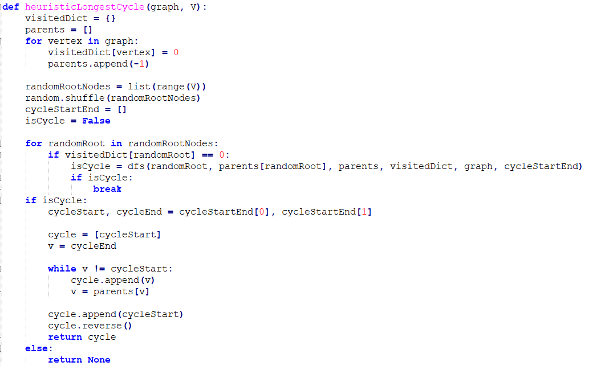
ALGORITHM DESCRIPTION

Slide 8
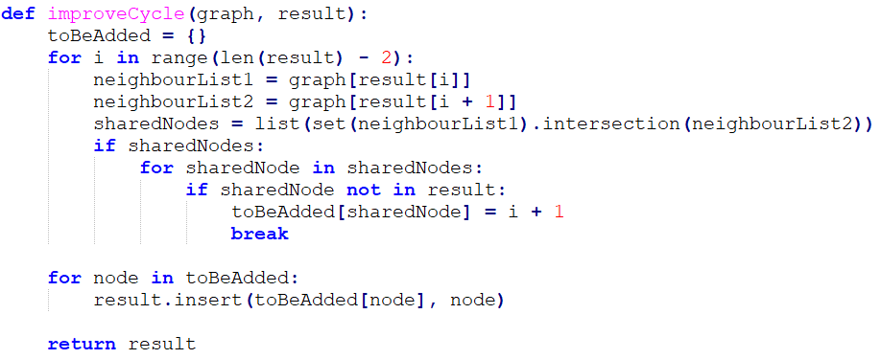
ALGORITHM DESCRIPTION

Slide 9
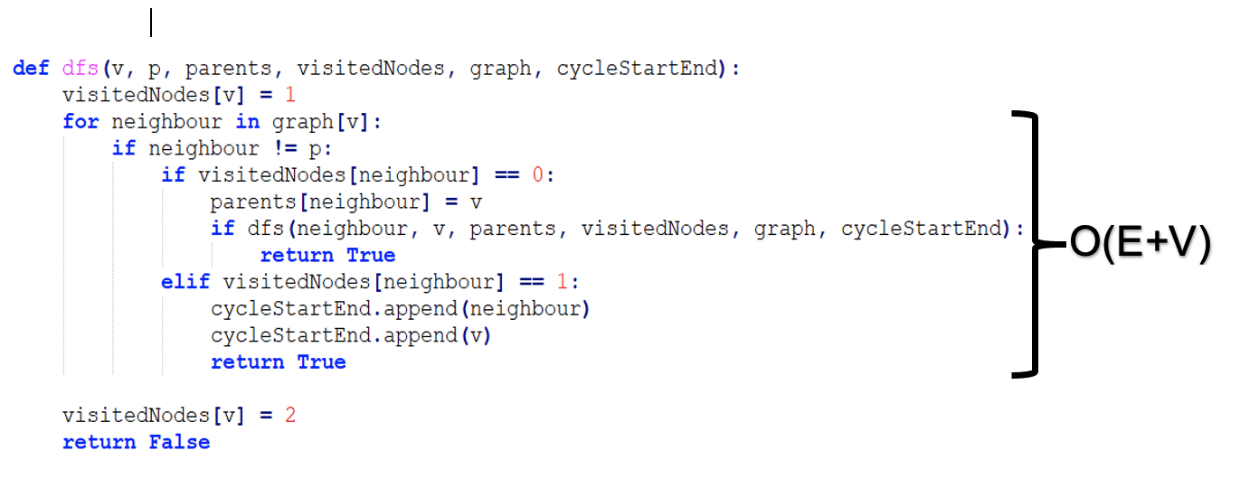
ALGORITHM ANALYSIS

Slide 10
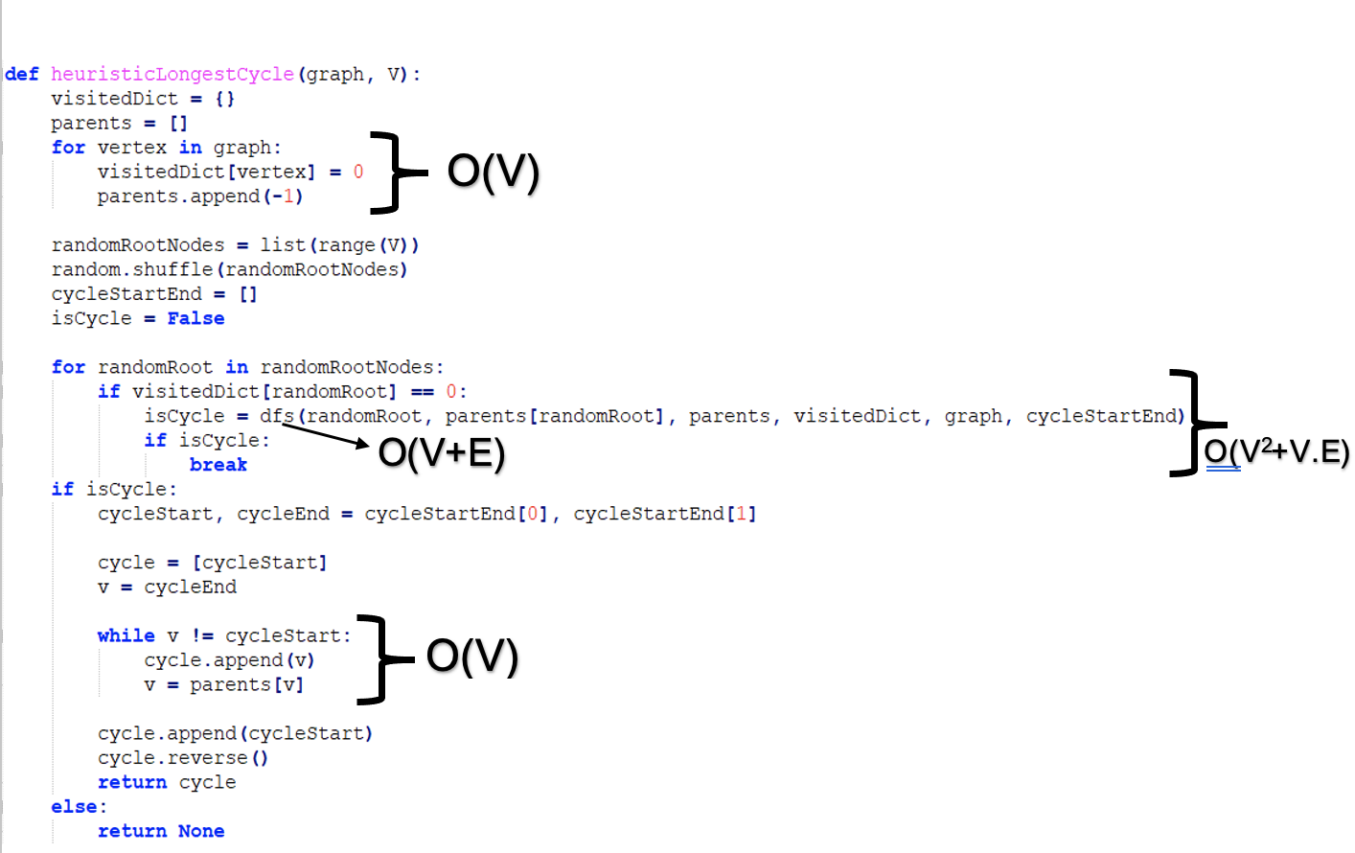
ALGORITHM ANALYSIS

Slide 11
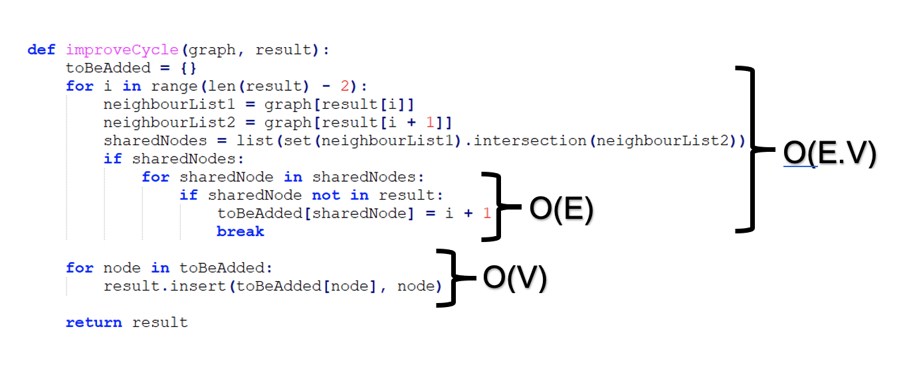
ALGORITHM ANALYSIS
The total time for finding a cycle and improving it is O(V^2 +VE) + O(VE), so it will cost at most O(V^2 +VE).

Slide 12
Practical Ratio Bound
Practical ratio bound by testing (graphs with small sizes)
Ratio Bound = AVG[Size(Exact Solution) / Size(Heuristic Solution)] = 1.3

Slide 13
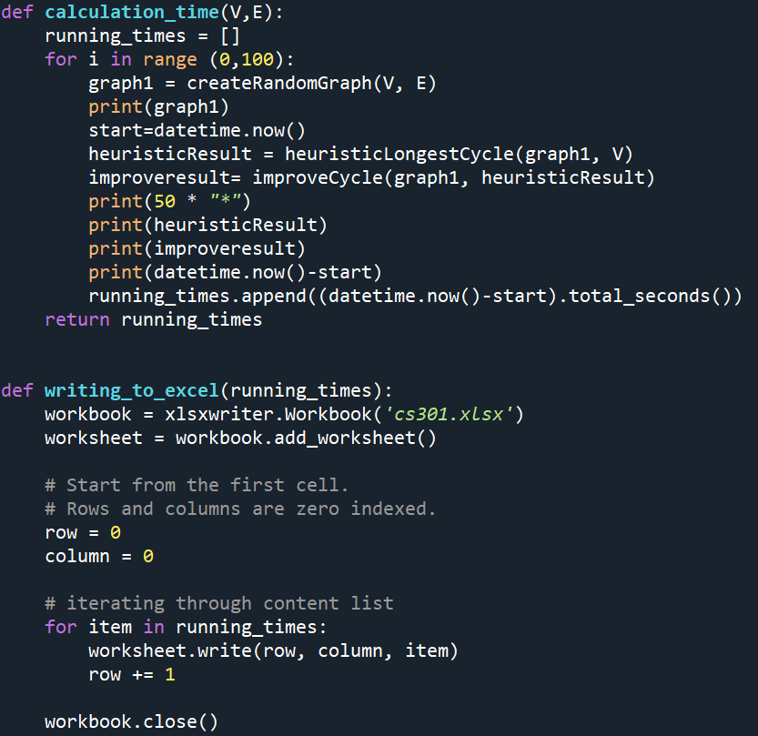
EXPERIMENTAL ANALYSIS
Running time experimental analysis

Slide 14
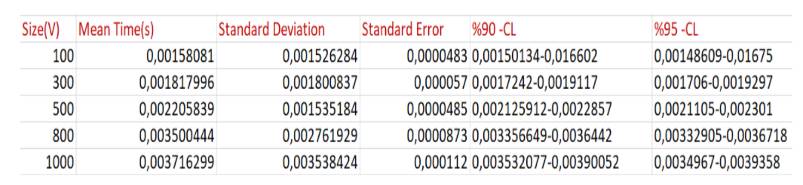
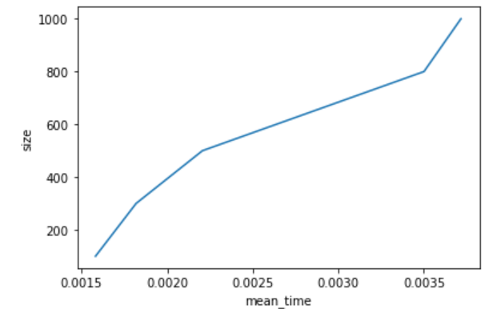
1000 Number of Iterations per each Input Size (E = 200)

Slide 15
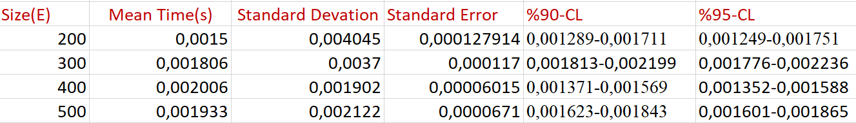
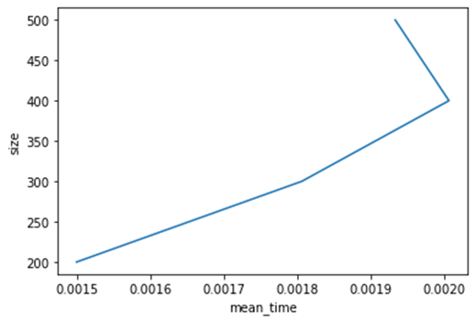
1000 Number of Iterations per each Input Size, vertex number is constant

Slide 16
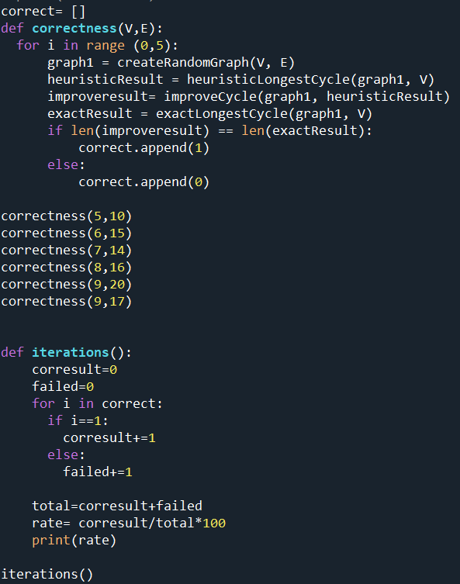
CORRECTNESS
Correctness rate is 20%
Correctness rate decreases when number of vertices increases

Slide 17
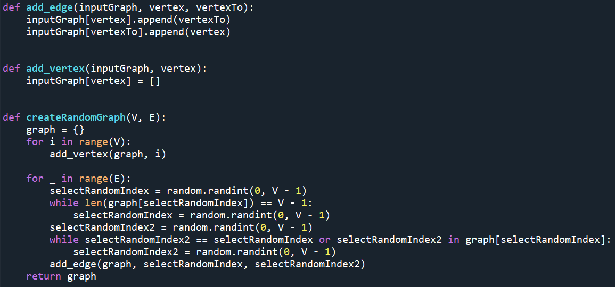
TESTING

Slide 18
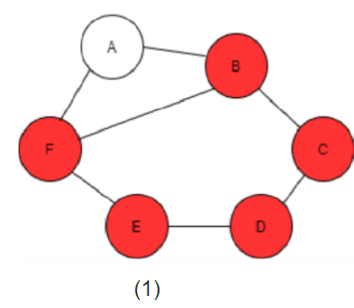
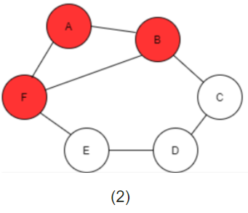
FAILED: Graph (1) represents the longest simple cycle which has 5 vertices for this graph but our algorithm failed to find it for this instance. It generated the outcome given in graph(2) which has 3 vertices.

Slide 19

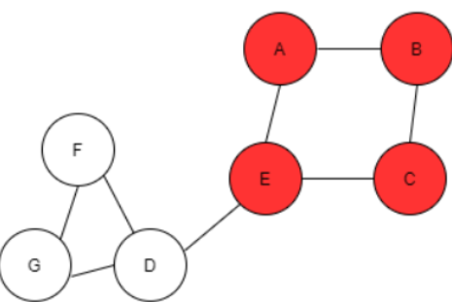
SUCCEEDED: The algorithm found the longest cycle with randomly picking one of the vertices and looked at its neighbours, because of the initial vertex it found correctly.

Slide 20
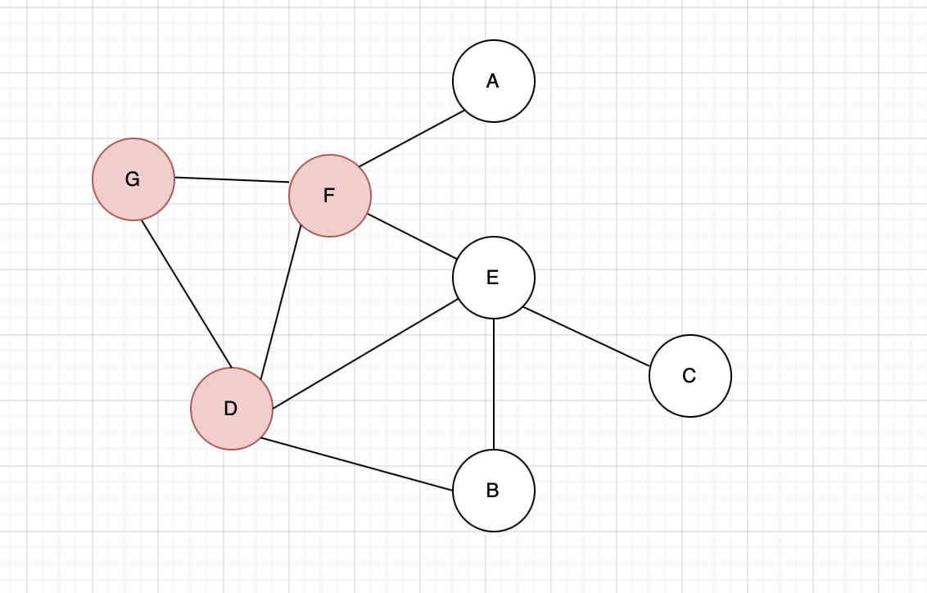
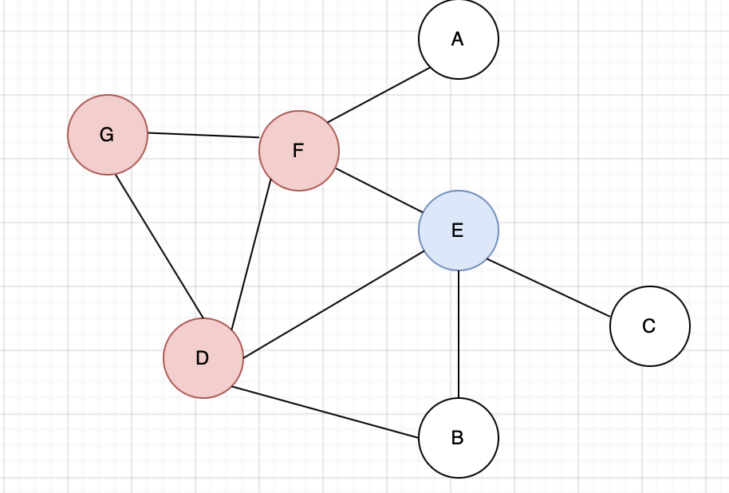
FAILED: Graph(1) represents the cycle but not the longest one with 3 vertices. In the improveCycle part, we find the vertex E, then add it to the cycle that we had in Graph(1). But also this graph(2) is not the longest one since we cannot add B.

Slide 21
DISCUSSION
Not always gives longest cycle
Complexity O(V^2+VE), dfs + improvement
Correctness decreases when V,E increases (average 20%)
Ratio bound AVG(Size(Exact Solution) / Size(Heuristic Solution))

Slide 22
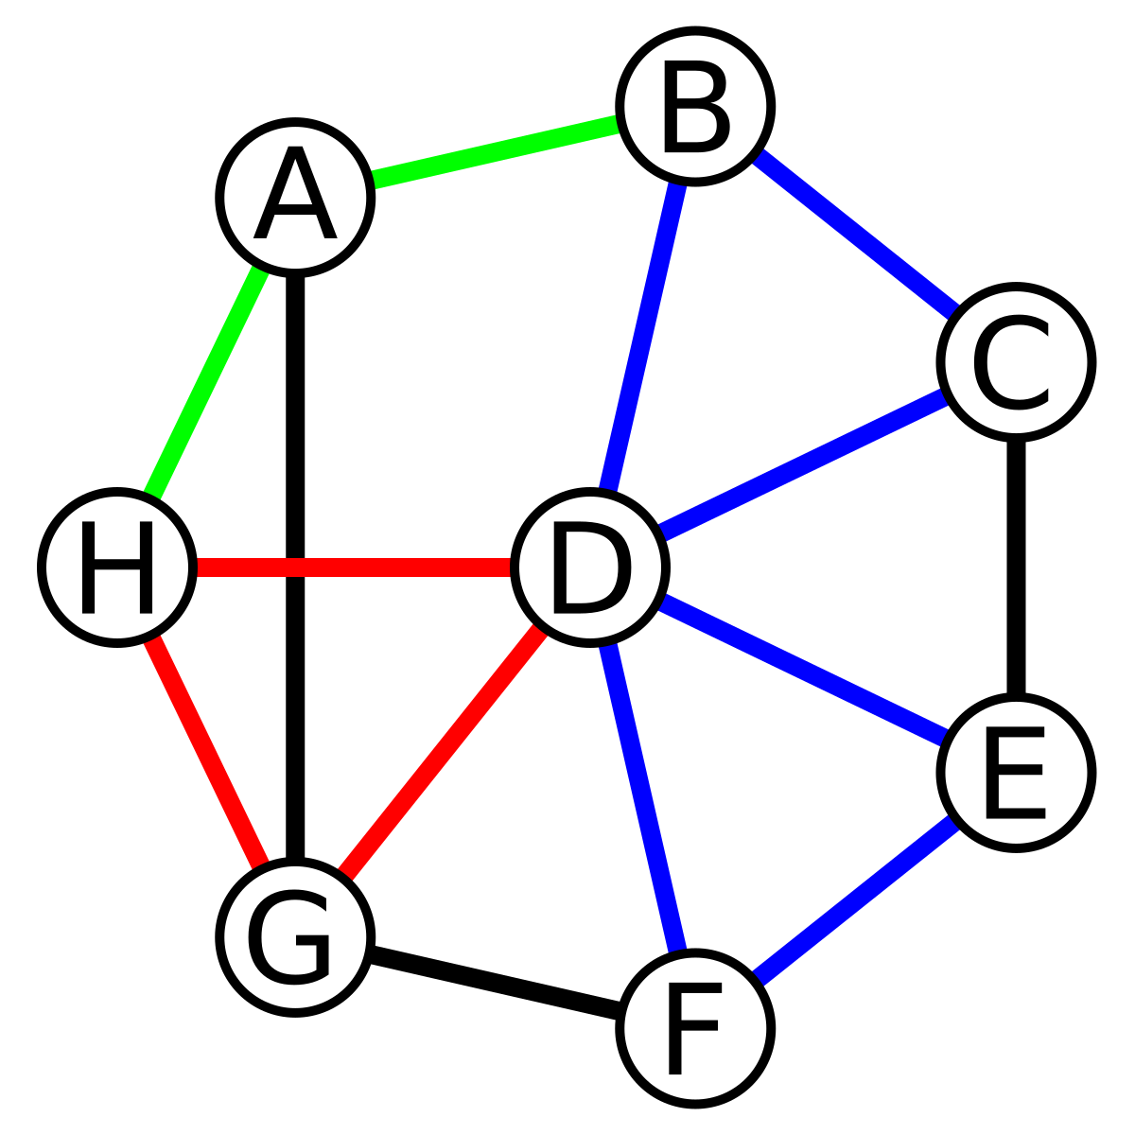
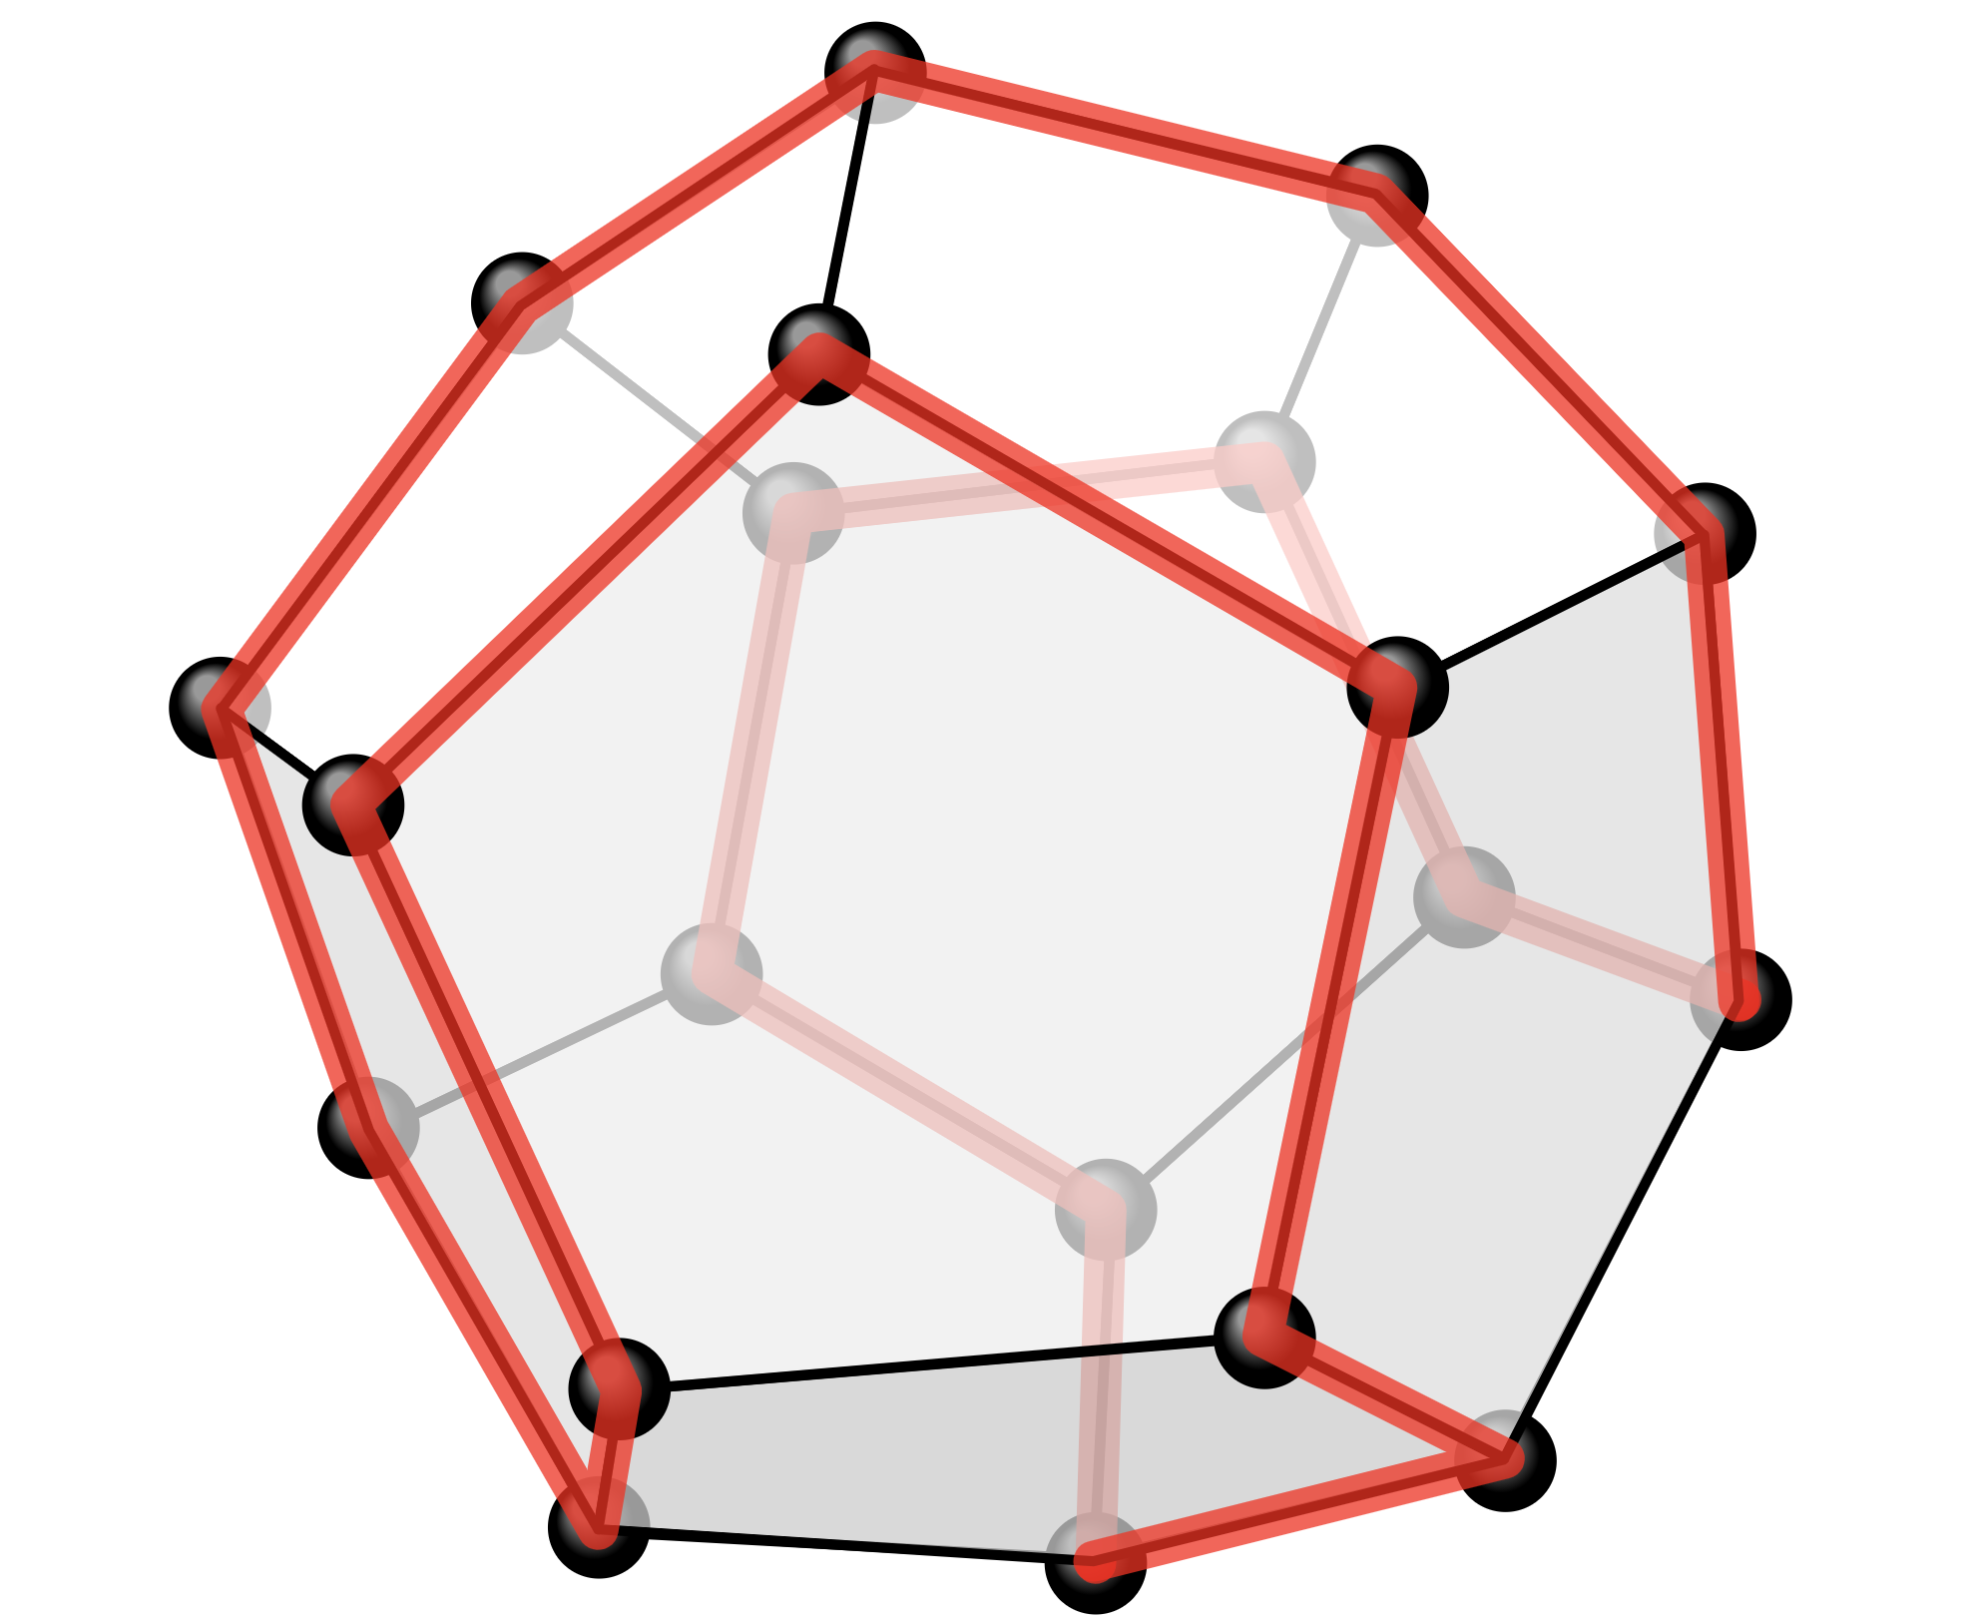
Thank you for listening :)

